Slide 1
AP ALUMNI

Slide 2
Marlon Ramos Reed High Class of 2010
University of Nevada, Reno Class of 2014
“High school asks one thing. College demands another.
That is to say, the time dedication and rigor of material are polar opposites. The advanced placement program, however, can help narrow this gap.
The whole purpose of advanced placement is to prepare you to think; to critically examine what you know and apply it to solve a real problem. Regardless of the subject of study, the questions tailor to a synthesis of concepts.”

Slide 3
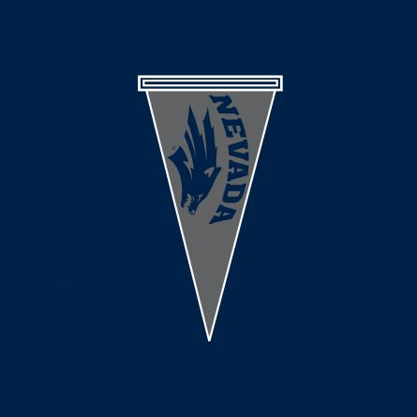
Elizabeth Browne Reed High Class of 2009
University of Nevada, Reno Class of 2013
“When I signed up for AP English I wasn't sure what to expect. The AP courses seemed like a VIP club for
genius students with 4.0 GPAs, and I didn't count
myself as one of those. Where most students got on
the AP track during their freshman year, I was a
senior. I didn't think I would learn much of use so
late in the game.
Fortunately, I was wrong. I learned an incredible
amount. I admit, in the beginning I relied on
Sparknotes because I didn't know how to write out the
assignments. But by the end of the year I no longer
needed it. There were still students in the class who
could analyze scenes from Beowulf better than I
could, but the feeling of self improvement was
fantastic. I gained more confidence in myself and my
abilities.”

Slide 4
Caleb Cage Reed High Class of 1998
West Point Class of 2002
Executive Director Nevada Veterans Services
“I have long been a believer in the idea that you get out of your education what you put into it. The Honors program at the high school level, which I participated in at Reed nearly fifteen years ago, is an excellent first step in getting the most out of your academic experience, but, I do not believe that I can overstate the importance the courses had in my personal academic development. They were absolutely the high point of my high school career with respect to my own intellectual development.”

Slide 5
Laura Janca Reed High Class of 2010
University of Nevada, Reno Class of 2014
“AP English helped me a lot when I got to college. Though there were many times I felt like I wasn't learning anything when I look back on it now I can see that pretty much every day I learned something new that will stay with me forever. I was never very strong in English and I didn't care for writing or reading out loud, but now, after AP English, I have begun writing more and my reading has improved dramatically. Having taken AP English both Jr. and Sr. years of high school and AP Government my Sr. year I have become better at managing my time so that I can get everything done on time without staying up all night the night before to get it all done.”

Slide 6
Angelina Cardona Reed High Class of 2007 Student Body President
Stanford University Class of 2011
President - Associated Students of Stanford University
Taking AP classes at Reed High School was the best way for me to prepare not only for the academically rigorous environment at Stanford University but also for the extra-curricular activities that I have pursued while in college. AP English class gave me the tools to create pieces of writing that were simultaneously intellectual and creative. These tools have given me a foundation of confidence to write several opinion editorials in my school newspaper and to produce several public statements and speeches in my role as Student Body President.

Slide 7
Tony Lin Reed High Class of 2010 Valedictorian
University of California Los Angeles Class of 2014
“AP saved my butt. Lots of people here got special tutoring and whatnot and took college classes already so they already knew the material of the class. It sucks because they jack the curve high and screw the people who are just learning it. Also the professors here don't test to see whether you know the material or not because everyone works hard and knows it and would otherwise all get A's. They instead test you on application, giving insanely hard questions that require everyone to think outside the box and make use of all the material learned -- that’s how tests are. So...AP has helped a lot because all professors assumed you have taken the classes and know the material and go straight into the stuff afterward.”

Slide 8
Jenna Bruce Reed High Class of 2006
Lewis & Clark School of Law
“The AP Program has been instrumental. AP courses set me in motion towards a successful college career, and there are many reasons to pursue AP. The most tangible reason is the ability to start college with credits from English, history, science, math, or foreign languages. Although some may not apply directly to your degree, they helped me get ahead.”

Slide 9
Shannon Wroblewski Reed High Class of 2006
University of Nevada, Reno Class of 2010
“AP classes were challenging of course, but they prepared me for the college scene when many of my other high school classes fell short. I learned how to construct papers and be confident in my writing, I was prepared for the work load college presented, and the knowledge that I acquired still makes a difference every day.
I remember getting to UNR and feeling like I could take on the challenges presented. I know AP classes are the reason for my many successes at the college level. I recommend AP classes to everyone I know. There's really nothing comparable that can prepare you for college.”

Slide 10
Linden Reid Reed High Class of 2010
“My friend Sara is a Creative Writing major, and had to take remedial math classes because her high school did not offer AP classes. According to my score on the SAT, I should have been in the same math classes, which would have meant I would have had to take remedial math 1, remedial math 2, algebra 1, trig 1, algebra 2, statistics, and then calculus. That would have put me taking calculus as a senior in college. I was only narrowly able to weasel my way into calculus as a freshman, and really, it's not that challenging.
So, in summation, I think that I can say that yes, AP classes do prepare students for college to some extent. They fill students with knowledge that they will be learning in the next few years, which can help them a great deal by making their classes much easier.”

Slide 11
Chris Salls Reed High Class of 2010 Valedictorian National Merit Scholar
University of Nevada, Reno Class of 2014

Slide 12
AP ALUMNI

Slide 13
Emily Punzalan Reed High Class of 2010
“Aside from the obvious benefit of saving time and money by earning college credit for AP classes, I guess the most beneficial thing about taking AP is that it teaches you how colleges want you to think. In English specifically, you get a good idea about what level you need to be reading and analyzing texts. In general though, it also gives you a solid set of basic skills on how to approach a piece of writing, whether it's poetry, literature, or some kind of historical document.”

Slide 14
Annalise Vine Reed High Class of 2009 Valedictorian
Lewis & Clark College Class of 2013

Slide 15
Mackenzie Parker Reed High Class of 2009
University of Nevada, Reno Class of 2013
“The work load for AP classes can be demanding and challenging, but it is fairly close to an actual college setting in terms of the material as well as the relationship between the teachers and students. In my AP classes at Reed, I was treated more like an adult than a teenager. The learning process is ultimately up to the student, and it is easier to find your own individual style in high school with the guidance of teachers and smaller class sizes than during crunch time in that first semester of college.”

Slide 16
Kevin Carter Reed High Class of 2006
BA American University
MA Georgetown University
Presidential Management Fellow at the US Office of Personnel Management
“I graduated with both my undergraduate and with a Master's in a total of four years – two years fewer than typical. I was only able to do so because I took and passed AP classes at Reed High. I stepped onto campus with a year of college already completed thanks to AP credit. With my basic math, science, and writing courses out of the way, I was able to take courses that interested me, gain experience through interning, and even study abroad in the Middle East.”

Slide 17
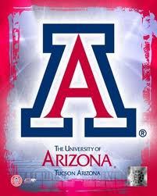
Kaitlyn Kelhetter Reed High Class of 2009
University of Arizona Class of 2013

Slide 18
Jeanine Duong Reed High Class of 2009
Pacific University Class of 2013
“The AP program overprepared me for college. With AP English, I feel like the expository writing class they're trying to put me through is pretty redundant and not nearly as informative. Not only can I write papers more effectively, but I can also analyze literature, something they didn't put into the curriculum of my writing class. If a student did well in AP English, they shouldn't have to worry about doing poorly in college essays.
It's really been useful and I've been able to refer the heck out of The Scarlet Letter and feel freakishly literate every time. I was pretty surprised at all the writing I had to do in all of my science classes and, even though it's not quite the same style of writing, AP helped me organize my thoughts and papers pretty well.”

Slide 19
Rebekah Pingle Reed High Class of 2009
University of Nevada, Reno Class of 2012
“Taking AP classes in high school was probably the best thing that I could have done to prepare for college. Even beyond earning credits and being able to lighten my college load, taking advanced classes helped me begin to cultivate the skills that I need in college, whether that be writing quickly or being able to study more effectively”

Slide 20
Jessica (Hooft) Crane Reed High Class of 2005
University of Nevada, Reno Class of 2009
“I'd have to say my most advantageous AP class was Calculus. There is no question that I would not have kept up in my Honors Calc class in college had I not taken it in high school. Even though I had passed the AP test, I chose to retake Calc I in college for both review and Honors credits. About 95% of my class was doing the same thing, and the other 5% were struggling. I ended up taking Calc II as an elective (who does that?!?!) because I enjoyed Calc I so much the second time around.”

Slide 21
Meagan Eng Reed High Class of 2008
University of Nevada, Reno Class of 2012

Slide 22
Jenna Bruce Reed High Class of 2006
Lewis & Clark School of Law
“Another reason is the one-on-one help from teachers. In your introductory classes in college you will have large classes and less interaction with the professors. My writing skills improved because of the catered responses to my writing in AP classes, and honestly, it is where I learned to write well. I am now in law school, and I attribute my writing basics to those I learned in the AP program.”

Slide 23
Carsen Berger Reed High Class of 2008 National Merit Finalist
University of Chicago Class of 2012

Slide 24
AP ALUMNI

Slide 25
Caleb Cage Reed High Class of 1998
West Point Class of 2002
Executive Director Nevada Veterans Services
“I clearly remember taking Advanced Placement courses in the subjects of American History, Government, and English, which was a continuation on Honors courses I had already taken on the subjects of early American literature. Although I always found my courses in math and science to be challenging, the Advanced Placement courses I took were the most enjoyable and the most challenging courses that I took during my entire high school career. I found them to be inspiring, challenging, and an excellent source of my own development.”

Slide 26
Maggie Tietz Reed High Class of 2008 National Merit Finalist
Scripps College Class of 2012

Slide 27
Keely Thoreson Reed High Class of 2009
University of Nevada, Reno Class of 2013
“Financially, my parents were grateful for me passing the AP tests, since they paid 560 dollars for 28 credits instead of 6,000 dollars. In addition, my experience taking AP courses allowed me to adapt to college more quickly than most students, evidence by a higher GPA. Although school teachers warn of the "impending doom (difficulties)" that await at the next academic institution, I found my freshman year courses only slightly different than my AP classes. Often times, I found myself prepared and already knowledgeable of the concept or matter being presented in lectures. I can't emphasize enough the confidence I acquired from being ahead academically.”

Slide 28
Angelina Cardona Reed High Class of 2007 Student Body President
Stanford University Class of 2011
President - Associated Students of Stanford University
My academic curiosity was particularly sparked in AP History and has led me to pursue a Bachelor of Arts in International Relations. AP Spanish led me to take two additional years of Spanish in college and allowed me to study abroad for a quarter in Madrid, Spain. I will be graduating this June, yet it seems like yesterday that I was learning and engaging in my AP classes at Reed. I am so thankful that I had the opportunity to challenge myself during high school and prepare for the myriad of opportunities I’ve enjoyed while in college.

Slide 29
Elizabeth Browne Reed High Class of 2009
University of Nevada, Reno Class of 2013
“The best thing about AP English is that it doesn't stop at the end of the year. Taking the course is like discovering a whole new way of thinking. It stays with you. At the University of Nevada I rocketed through English 102, 282, and 298. I was familiar with the concepts and texts we studied in 303 and 311. I breezed through the first Core Humanities class. And it wasn't just a boost to my grades. In AP English you learn life skills. I can read and analyze texts, write effective papers, and articulate my ideas more clearly. You would be amazed at how many college students, even juniors and seniors, struggle with such things. Even if you are not aiming for an English degree, the skills you learn in AP English are invaluable. I don't know how I would have made it so far if I had not taken the class.”

Slide 30
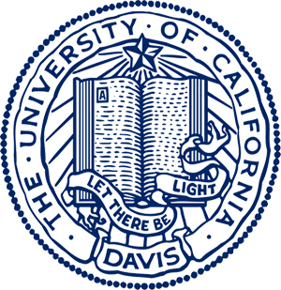
Billy Hong Reed High Class of 2006
University of California, Davis Class of 2010

Slide 31
Kevin Eckes Reed High Class of 2005
Cornell University Class of 2009
Currently pursuing PhD University of Texas
“My experience with the AP program was very positive. In my AP courses I was held to a higher standard and therefore had to work harder to keep up with the pace and workload. The relative rigor of these courses prepared me quite well for college. I ended up going to Cornell University to study Biological Engineering. At Cornell I certainly continued to improve my writing and communication skills, but having the AP background made the transition to college level writing fairly easy.”

Slide 32
Janay Stevens Reed High Class of 2006
University of Nevada, Reno Class of 2010

Slide 33
Sarah McDaniels Reed High Class of 2005
University of San Diego Class of 2009
“The benefits of taking AP classes that I enjoyed most were probably more holistic than anything, most notably the sparking of intellectual discussion in lieu of just having information dictated to you. I think this goes without saying, but the increased rigor of AP classes is comparable to that of college courses.”

Slide 34
Nicholas Bombard Reed High Class of 2008 National Merit Scholar
University of Southern California Class of 2012

Slide 35
Rebekah Pingle Reed High Class of 2009
University of Nevada, Reno Class of 2012
“What you get out of AP classes depends on what you put into them. If you cheat yourself out of the experience by "working with others" or reading SparkNotes instead of the assigned books, you will probably not pass the test at the end of the semester, nor will you develop good academic skills.
Finally, many students make the mistake of taking a really light load senior year, but I would highly warn against that. If you get out of the habit of doing school, you will get into the mindset that school is easy and make the mistake that countless college freshmen make their first semester. You may think, "I've always been an A student," but many an A student falls victim to the aforementioned academic laziness.”

Slide 36
AP ALUMNI

Slide 37
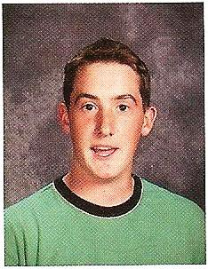
Max Fleming Reed High Class of 2006
University of Nevada, Reno Class of 2010
“As for college stuff...the obvious thing to say is that AP got me out of English 101, and it could have gotten me out of 102 if I’d tested better. I'm happy I had to take 102 though. I had a pretty good teacher for that class, and it was a good experience overall. I think I was a lot more successful in that class than I would have been without the AP experience. Technically and creatively, I was a much better writer.”

Slide 38
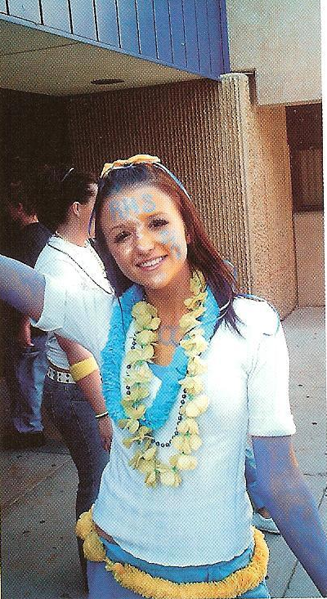
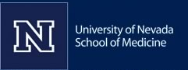
Nicki Joslyn Reed High Class of 2006
University of Nevada, Reno Class of 2010
University of Nevada School of Medicine

Slide 39
Elizabeth Janca Reed High Class of 2006 Valedictorian
United States Naval Academy Class of 2010
“AP English taught me the importance of having a dislecture instead of a lecture – you learn more! Lit devices increased my vocabulary as well as my reading analysis. The word "juxtaposition" is my favorite lit device, which I still use. Good classic books (and some that are not so good) are commonly quoted. Helped immensely with English in college. Although I was not able to validate freshmen English, I was put in the honors English class and had a really good time. Papers were not as difficult to write because AP English taught me how to analyze and write about passages – in a short period of time! Due to the caliber of the class, common things (hyphen, dash, apostrophe, etc) were explained in a different light, that stuck!”

Slide 40
Elizabeth Browne Reed High Class of 2009
University of Nevada, Reno Class of 2013
“And it's FUN! This isn't just poring over dusty old classics or memorizing literary terms. You learn about other cultures, times, and places. You get to enjoy satire, attempt Middle English, and act out battle scenes from Beowulf. You watch movies and talk about crazy ideas. And eventually you'll be able to impress people with love poetry and witty dialogue. (Always a plus.) Yes, the course is challenging. But is it worth it? Definitely.”

Slide 41
Kevin Carter Reed High Class of 2006
BA American University
MA Georgetown University
Presidential Management Fellow at the US Office of Personnel Management
“AP credit also saved me money. My college awarded a total of 12 credits for just my scores on the English Literature and English Language tests. That's a great deal considering that AP tests only cost $87, which is substantially less than the $1,577 per credit hour American University charged me.
I have many friends right now who are under crippling debt from school loans – I’m talking about six-figure debt. And I feel incredibly lucky that I'm done with school, having the opportunities I did, without racking up very much debt. AP classes helped without a doubt.”

Slide 42
Derrick Atkinson Reed High Class of 2007
Boston Conservatory Class of 2011

Slide 43
Marlon Ramos Reed High Class of 2010
“Personally, taking AP in high school was rewarding in the respect that I knew not only how much work was required, but how it needed to be approached. For example, AP English courses stress citing text to support a claim, something which is mandatory in every paper I have written in college. Similarly, AP science courses helped me pay close attention to the interplay of lecture and labs in college.
Its importance lies not in the lengthy, grueling examination held in May each year, but in what you learn to do up to that moment. You learn to think.”
University of Nevada, Reno Class of 2014

Slide 44
Laura Janca Reed High Class of 2010
University of Nevada, Reno Class of 2010
“Of all the classes I took in high school my AP classes were the ones that I took most from. Depending on who you end up getting for a teacher in college and where you go, AP English asks more of you and the teachers are easy to find and give you baby steps to help you through writing your papers. I think the AP classes are very valuable to those students who want to go on to college and make something of themselves, and even if you don't pass the test in the Spring you can take so much from these classes that will help you later in college.”

Slide 45
Jenna Bruce Reed High Class of 2006
Lewis & Clark School of Law
“My friends who took AP courses did well in college and are now in successful careers. It is not a guarantee, but it puts you in the right path. As a disclaimer, AP is not the same as a college course. High school courses cannot simulate the college atmosphere, but AP does provide a strong foundation that will give you a leg up in the collegiate world. I recommend taking courses you are interested in, and those that will help you in your future (if you have a clue what field you want to pursue). I enjoyed my courses because of the material and challenge they offered. Take advantage while you can -- if you put in the time now, it will pay off!”

Slide 46
Caleb Cage Reed High Class of 1998
West Point Class of 2002
Executive Director Nevada Veterans Services
“There is a perfect illustration of the significance of these Advanced Place courses that I took—American History, Government, and English. In college, I spent the better part of my first two years trying to figure out a major that incorporated all three of these subjects. I considered Majors in the Philosophy, History, and Political Science Departments for quite some time. In the end, I finally decided to Major in Early American History, writing my thesis on the roll of early American literature in the developments of the Revolutionary War and the Early Republic. I personally trace this major decision in my life, one that I have been happy with my entire post-education career, back to the Advanced Placement courses I took while at Reed High School. My only regret is that I didn’t take more of them.”

Slide 47
Megan Fitzpatrick Reed High Class of 2009
University of Nevada, Reno Class of 2013
“I'd love to share my experience! It honestly was the best thing I could have done for myself. It made my first year in college less stressful because I actually had a clue as to what professors were expecting with papers, and midterms and finals were easier to prepare for because of the preparation that was done for the AP exams. In some ways, the classes I took my first semester were actually easier than the AP classes I took because my professors were going over material I had already learned over the last two years in high school.”

Slide 48
AP ALUMNI

Slide 49
Megan Weinhold Reed High Class of 2006
University of Nevada Reno Class of 2010

Slide 50
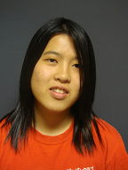
Grace Lee Reed High Class of 2009
University of Notre Dame Class of 2013
“AP classes made a significant difference for me in my college career for two basic reasons. First, the credits I received from the tests I scored high enough on allowed me to take other courses instead of using the space for basic requirements, which happens to come in handy because it just makes life so much better when you're able to take a class you truly enjoy. Second, taking a college class that covers similar material was so much easier the second time around. I didn't have to spend nearly as much time studying as some other people who never studied the subject.”

Slide 51
Keely Thoreson Reed High Class of 2009
University of Nevada, Reno Class of 2013
“Moreover, I developed academic and life skills in regards to effective studying, writing well, taking tests carefully, and thinking critically. Undoubtedly, the rigor of AP courses overwhelms any student at first, yet one adjusts to the challenges, the demands, of these courses and by the end of the year, the class is over and something new (sometimes more) has been cemented into one's vast library of information, also known as the brain. These higher academic classes require commitment and application, yet sure enough learning occurs and in the meantime the AP tests are passed with 4's and 5's. AP courses are worth the effort and time in preparation for college and preparation for life.”

Slide 52
Sarah McDaniels Reed High Class of 2005
University of San Diego Class of 2009
“AP English classes not only expanded my vocabulary but also molded me into an eloquent writer, which is very, very helpful in my field because scientists often are very poor writers. Believe it or not, I was tested on two passages that we had discussed in Mrs. Rishel's class on the verbal section of the MCAT as well. And finally, the English AP classes have given me a lasting appreciation of literature and I think have helped me become a more rounded and well-read individual.”

Slide 53
Audrey Hill Reed High Class of 2008
University of Nevada, Reno Class of 2011

Slide 54
Evan Pritsos Reed High Class of 2009
Occidental College Class of 2013
“To anyone who really wants to succeed in college, I highly recommend fully utilizing the AP program. Mr. Hoadley and Mrs. Rishel will teach you how to write in a way college professors expect. At my school, we were required as freshmen to take introductory courses that focused on teaching new students how to write college level papers. I found that applying the techniques I learned in my two years of AP English I was able to breeze through that course and avoid the second semester "Special Writing Course" many of my classmates were forced to endure.”

Slide 55
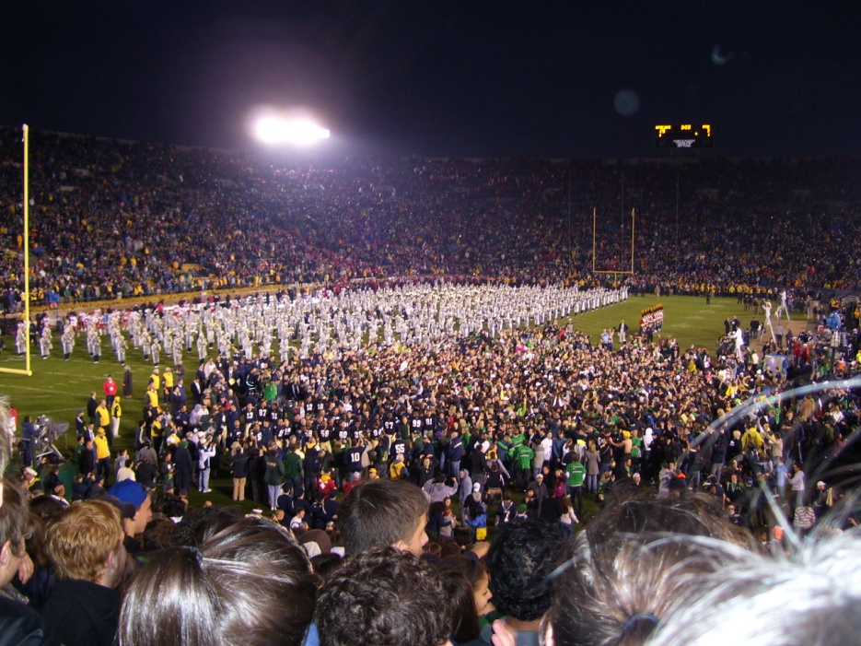
Emily Punzalan Reed High Class of 2010
University of Notre Dame Class of 2014
“I guess part of how well you feel AP prepares you for college depends on where you end up going, but I can honestly say, whether you wind up earning college credit or not, AP gives you a good foundation for the skills necessary for college. The key to survival is learning how to adapt them to new subjects and styles of learning and to do it quickly.”

Slide 56
Jessica (Hooft) Crane Reed High Class of 2005
University of Nevada, Reno Class of 2009
“Because of AP English, I ended up only have to take one English class in college. It was a one credit class and met once a week (i.e. super easy.) I felt like AP classes prepared me well for analyzing literature (which you do in EVERY SINGLE COURSE, regardless of what subject) and composing and organizing essays. A lot of my dorm mates complained about their English classes being a lot of work and very time consuming, not to mention boring. AP English was a lot of work too but worth it.”

Slide 57
Keely Thoreson Reed High Class of 2009
University of Nevada, Reno Class of 2013
“I certainly have reaped the benefits from AP classes. I guess the most obvious reward from taking AP courses was passing the tests and practically skipping my first year of college. I am now able to dual degree at UNR and do so in four years -- unlikely to have happened if I had not entered college "ahead of the pack" (no pun intended).”

Slide 58
Jared Olson Reed High Class of 2006
University of Nevada, Reno Class of 2012
Engineering Intern
“I would tell any high school student who is even considering going to college to take as many AP classes as they can. AP classes are a great way to condition yourself for college. In college, students are required to learn difficult material in short periods of time. AP classes are opportunities for students to cover the same difficult material they would receive in college, at a more comfortable pace, and from a teacher who enjoys teaching.
AP classes are like a bridge between high school and college. They allow you to see what direction you want to take once you get into college. I did well in and enjoyed both AP calculus and AP chemistry, but I had a harder time in AP English. Because I experienced that in high school, I was able to make a decision about my major (Chemical Engineering) very early on in college. Most importantly to me, I saved money by taking those classes early. Not only did I save money by not wasting time in college, but I got thousands of dollars worth of college credit for the price of 5 AP tests! Lastly, AP classes are an opportunity to surround yourself with other students who are focused and productive in a far richer learning environment.”

Slide 59
Kevin Carter Reed High Class of 2006
BA American University
MA Georgetown University
Presidential Management Fellow at the US Office of Personnel Management
“Finally, AP classes also teach you stuff... In my current job, I've written speeches for our presidentially appointed Director, budget justifications for members of Congress, and even my agency's response to one of the President's Executive Orders. My AP English courses provided the foundation on which I've developed as a successful writer. I think the teacher might have helped, a little too.”

Slide 60
AP ALUMNI

Slide 61
Sarah McDaniels Reed High Class of 2005
University of San Diego Class of 2009
“Although I took a lot of AP classes in the sciences as well, I don't think those benefited me as much as those in English because I began college taking advanced science courses anyway because of my decision to major in biology. However, it was helpful when registering for classes because registration is often based on number of credits you have accrued, so if you already have college credit that automatically allows you to register ahead of many of your classmates. This is particularly helpful if you attend a smaller university like I did because seats in classes are often very limited. It allows you to take the classes you want, when you want, with the best professors.”

Slide 62
Mackenzie Parker Reed High Class of 2009
University of Nevada, Reno Class of 2013
“I believe that the AP program is one of the wisest decisions a college bound student can make. Not only does it make the transition from high school to college much easier, but gaining credit from AP tests saves a ton of money! Because I passed both Mr. Hoadley’s AP test and Mrs. Rishel's, I was able to get credit for English 101 and 102, saving me both time and money to focus on the classes for my major.”

Slide 63
Maureen Choman Reed High Class of 2008
University of Notre Dame Class of 2012
(studying in Spain this year)
“Taking AP classes at Reed definitely helped me. I was able to get a lot of general university requirements out of the way, so when you go in with those credits, it makes it easier to pursue a minor or supplementary major. Also, with calculus for example, you learn the same amount in a year in high school that you do in a semester in college -- the pace is much faster in college and you have to work that much harder, so it's worth it to take it in high school when you have the time to go slow and space out a semester's worth of class in a year. And then credit/logistical things aside you just are more prepared for the college level after working so hard in high school. It makes the transition easier.”

Slide 64
Marie Terry Reed High Class of 2008
University of Nevada, Reno Class of 2013
“I took 7 AP classes in total while going to Reed High School and I did fairly well in all 7. AP classes allowed me to get a glimpse of what a college work load looks like. AP teachers tend to treat you more like an adult than a child, which is a huge plus about being in college. Not many student realize how far ahead taking AP classes can get you, credit wise, and with just being more prepared overall.”

Slide 65
Marisa Peri Reed High Class of 2007 Salutatorian
Georgetown University Class of 2011
Currently choosing a medical school
The most important part of AP classes for me was that they got me into Georgetown, which has been an extremely rewarding experience in the education it has provided me and the opportunities it has made available for me. Without my AP credits and test scores, I would not have been accepted here.
In respect to AP English, I wouldn't have been prepared to write an adequate paper at the college level, let alone a good college paper without both Junior and Senior AP. I have never received lower than a B+ grade on a paper at Georgetown, and I attribute at least part of that to AP English. In respect to AP History, that was my favorite class and now my major. AP Chemistry was my other favorite class and now I am going to medical school.
In summation I would say that AP classes give you the credentials you need for college, prepare you for college assignments, and help you discover your passions by challenging you (my personal favorite).

Slide 66
Rhiannon Gamboa Reed High Class of 2009
Northwest Nazarene University Class of 2013
“AP helped prepare me for college by teaching me to reason at a higher level. It also taught me how to write a college level paper in forty minutes which has helped in college with time management.”

Slide 67
Michelle Hoefer Reed High Class of 2006
University of Notre Dame Class of 2010
“Taking AP classes turns you into an interesting person by providing ways of communicating with other college students and general population because of common classic books read/studied. They accustom you to what college classes are like (read prior to coming to class and analyze/discuss during class). You don't realize how much you learned until later, but it is a good way of learning. It helped me form thesis statements. Poetry reading was very valuable. Exposure to a wide variety of poems taught me how to appreciate and enjoy poetry.”

Slide 68
Kevin Eckes Reed High Class of 2005
Cornell University Class of 2009
Currently pursuing PhD University of Texas
“My view of the AP program is definitely different now than it was when I was in high school. At that time, I was more focused on the fact that I might be able to earn college credit for taking these courses. The reality is that few universities fully and completely accept AP credit as degree-track credit. Having learned that, I still do not believe taking AP courses was a waste of time; quite the contrary. The advanced level of instruction and higher intellectual expectations were the most valuable part of the AP coursework.”

Slide 69
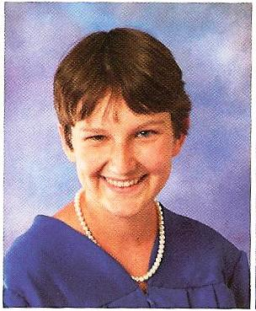
Quincy Sweeney Reed High Class of 2005 Presidential Scholar
Columbia University Class of 2009

Slide 70
Linden Reid Reed High Class of 2010
Sam Houston State University Class of 2014
“My AP science and English classes were helpful for me mostly in order to build up a base that was stable enough to start building knowledge on in college.”
“I can say from what I have learned so far that the classes in college are by far easier than any of the AP classes that I took in high school, especially Chemistry. My roommate is now in Chemistry 2, and nothing that she is learning even approaches the difficulty of material that I learned when I was in AP chemistry as a Junior in high school.”
Post-it Products Art Contest Entry

Slide 71
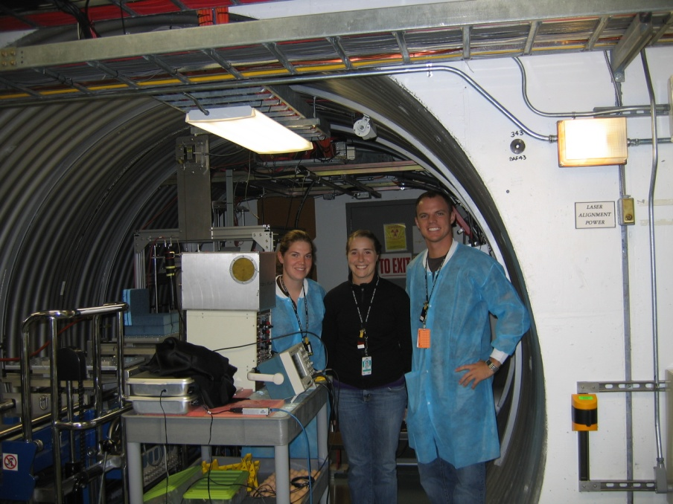
Elizabeth Janca Reed High Class of 2006 Valedictorian
United States Naval Academy Class of 2010
“Overall AP English (Junior and Senior year) were two of the better classes I took. I think I learned the most from them and they prepared me the best for college. If I were to go back and do high school again, I would take AP English (and other AP classes).
If possible, get out into the world beyond the realms of Nevada. College was a great time (most of the time) and I would do it all over again too.”

Slide 72
AP ALUMNI

Slide 73
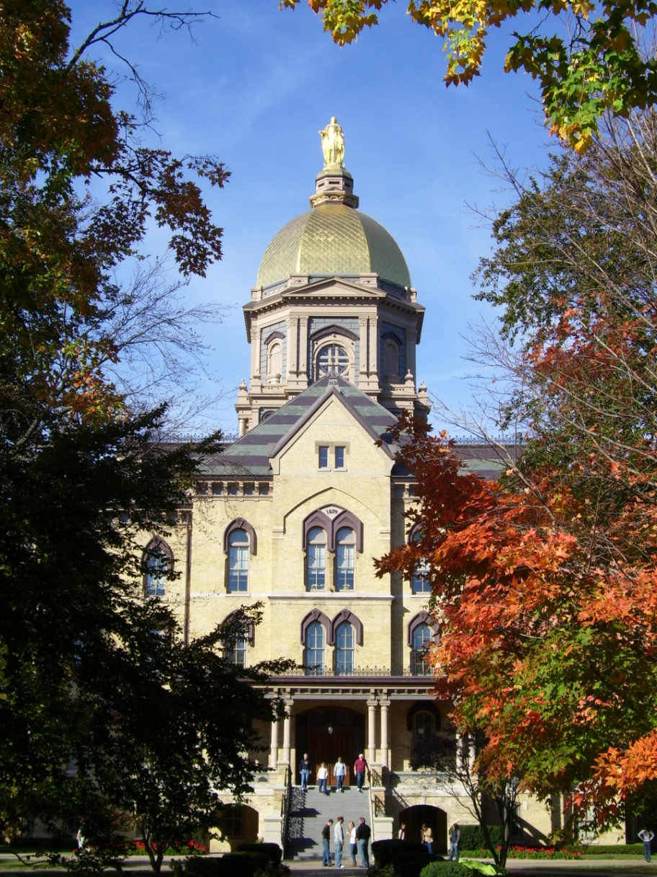
Emily Punzalan Reed High Class of 2010
“Since I got credit for AP English, I didn't have to take First Year Composition. This semester, I'm taking a literature seminar that focuses on biographies and autobiographies, and we have to write a paper on the book we're reading for the week. The type of writing we did for the AP test, like looking at lit devices and connecting them to something like purpose or theme, has been really helpful in that class since the writing assignments are pretty open ended.
Another AP skill that has been very useful is annotation. I probably would not have survived philosophy last semester without that handy little skill in my arsenal.”

Slide 74
Marie Terry Reed High Class of 2008
University of Nevada, Reno Class of 2013
“Although I did not pass all the AP tests, the ones that I did put me close to a semester ahead in credits, which eliminates taking useless electives just to have enough credits to graduate! The material was challenging, but I would say as a freshman in college, I was much more prepared for collegiate level classes. College classes rarely have mandatory attendance like high school classes, which makes going to class an option. Taking AP classes and having to attend them, made me realize how important it was to go to class while taking courses at that level.”

Slide 75
Yilok Wong Reed High Class of 2007 Valedictorian
Cornell University Class of 2011

Slide 76
Evan Pritsos Reed High Class of 2009
Occidental College Class of 2013
“But it’s not just about writing skills. These classes, along with AP History, Spanish and Government drilled into my head good reading habits. They taught me how to analyze books, articles, documents whatever, and to talk and write about them in an informed way. Many college courses are discussion based and learning to do required reading and being prepared to discuss are all important skill to possess.
The AP Math and Science courses are also helpful in preparing for college, with a more intense and rapid fire approach to material that most college level classes use. The skills learned in AP classes are the most useful you will ever learn, not to mention, the AP teachers are engaging, fun and bar none, the best teachers I've ever had. So take full advantage of all the AP courses you can. You won't be sorry you did.”

Slide 77
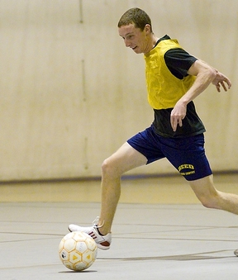
Steven Sweeney Reed High Class of 2007 Salutatorian
University of Chicago Class of 2011

Slide 78
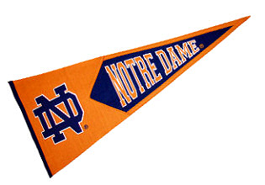
Grace Lee Reed High Class of 2009
University of Notre Dame Class of 2013
“Overall, AP classes ended up being more useful than I thought. Reed had a dedicated program and supporting teachers who helped me get to where I am today. It helps that the pace is faster in AP classes because there won't be any waiting or slowing down when the real college classes come around.”

Slide 79
Sophie Wong Reed High Class of 2005 Valedictorian
Massachusetts Institute of Technology Class of 2009
University of California, Berkeley Graduate Student, Bioengineering

Slide 80
Jessica (Hooft) Crane Reed High Class of 2005
University of Nevada, Reno Class of 2009
“I'd suggest taking AP classes for two reasons. One, if you pass the AP test it potentially puts you ahead which gives you flexibility overall in terms of creating your schedule each semester. It also makes it more likely to graduate "on time." Four years is sometimes not nearly enough so AP puts you on track. Sometimes AP classes get some of the core classes out of the way early so you can focus on your major, or classes you are interested in.”
“The other reason to take AP classes is for the experience. I know that sounds silly, but even if you don't pass, or pass high enough to get credit in college, it has its advantages. All AP classes prepare students for the types and paces of college courses. I used the exact same text book in AP Bio and my college Bio course. It also prepares you for what college finals are like. In high school I had very few finals that encompassed the entire semester, but in college most are like that. AP classes force you to remember what you've learned.”

Slide 81
Adrienne Hill Reed High Class of 2008
Southern Utah University Class of 2012

Slide 82
Max Fleming Reed High Class of 2006
University of Nevada, Reno Class of 2010
“AP English was absolutely the best class I took in high school. I didn't come anywhere close to being an English major in college (mechanical engineering), but I still took a lot away. I think it was the first class that got me thinking on that critical level where you actually learn and grow, and don't just memorize facts. At the time, I was blown away by the idea of having open discussions in class, where you could be honest, and people would actually consider what you had to say. Books were the base, but there was so much more that came up. Perhaps most importantly, it showed me that other media, and not just books, were legitimate sources of knowledge and insight.”

Slide 83
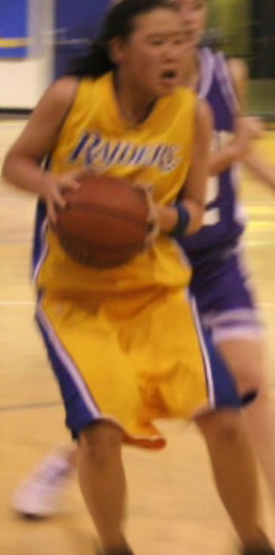
Stephanie Kao Reed High Class of 2008
Carnegie Mellon University Class of 2012

Slide 84
Aaron Benedetti Reed High Class of 2008 National Merit Finalist
University of Nevada, Reno Class of 2012
“AP courses, regardless of the scores students get on the exams or the number of credits universities grant for them, can introduce students to how college professors will expect them to think. And this is true of AP English courses especially, since writing is a major component of almost all college courses.
During my first few semesters, I used the kind of rhetorical and analytical strategies that the timed writes taught me while I drafted essays and read scholarly articles. I have a professor this semester who likes to talk about essays and articles in terms of extended arguments. I think I first started thinking in those terms in AP classes at Reed.”

Slide 85
Ray Hooft Reed High Class of 2006 National Merit $cholar
University of Nevada, Reno Class of 2011

Slide 86
Megan Fitzpatrick Reed High Class of 2009
University of Nevada, Reno Class of 2013
“And passing a test does WONDERS for your schedule! Skipping prerequisites is amazing because you can get ahead, or stay on a 4-year-plan if you're dual majoring. I know people who are already juniors after three semesters because of passing their AP exams. It leaves room for more fun classes, and classes that directly apply to your major instead of terribly boring prerequisites.
Even if you don't pass the AP test, the work you do will prepare you PLENTY for college classes. If you put in the time to do well in AP classes and work hard to pass the exam, freshman year will be a literal breeze.”

Slide 87
Shelby Moore Reed High Class of 2010
University of Nevada, Reno Class of 2014

Slide 88
Mackenzie Parker Reed High Class of 2009
University of Nevada, Reno Class of 2013
“The AP classes at Reed are taught over a semester, but the college equivalent is usually taught in one semester. This is why I highly encourage taking AP classes to get them out of the way in high school, especially for the more difficult math and science courses. Being able to take an entire year for calculus made it much easier for me to understand higher level math versus my friends who had to learn all of the same material in less than half of the time.
Because I chose to take AP classes in my junior and senior years of high school (and passed all of the tests), I had an entire semester of college under my belt before I began my first semester. This allows me to take 14-16 credits every semester and still graduate on time. That extra credit cushion prevents excruciatingly stressful semesters. Overall, taking as many AP classes as I could was one of the best decisions I made in high school.”

